Slide 1


Slide 2

Business Analytics and Visualization
Ajay Kumar Tadikonda - S4644464
Astha Anil Dholakiya - S4644484

Slide 3
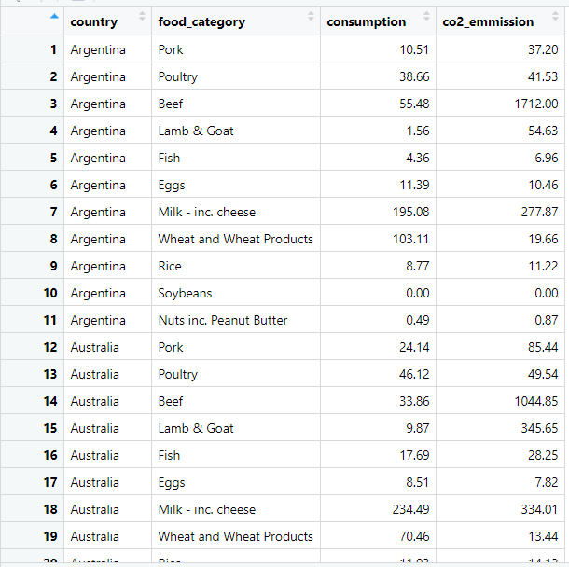

How does the Data look like?

Slide 4
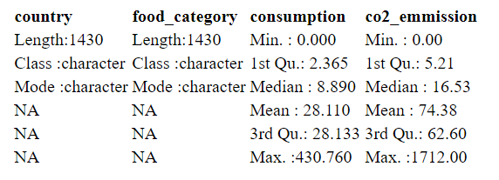
Summary of the Data

Slide 5
What’s in the Data?
Total No of Countries: 130 Total Food Categories: 11 Consumption Rate for each food category and their co2 Emissions

Slide 6

Findings
Can we predict the final CO2 emission by knowing their consumption and food category?
How many types of food_categories are there?
What is the relation between the consumption and the final co2_emmission.
What is the relation between the consumption and the final co2_emmission depending on food_category?

Slide 7

Problem is?
Greater CO2 Emmision and in this case, emission is mainly caused mainly by Beef

Slide 8
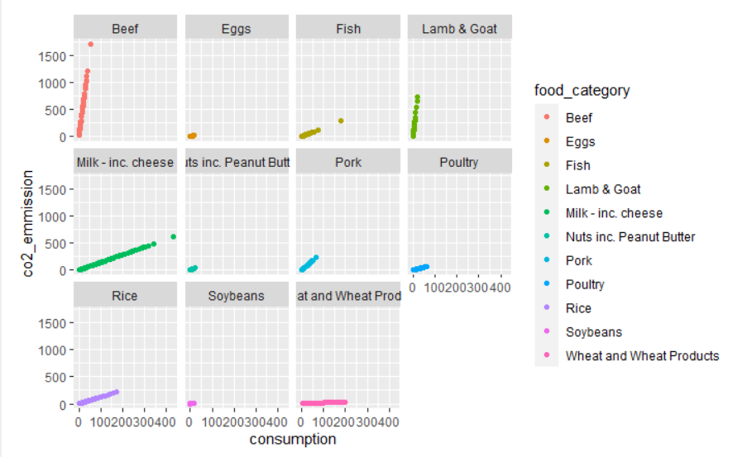
Comparing the emissions.

Slide 9
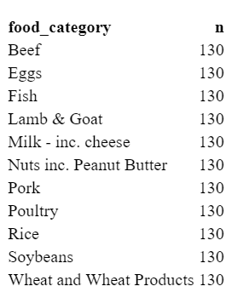
Food Categories

Slide 10
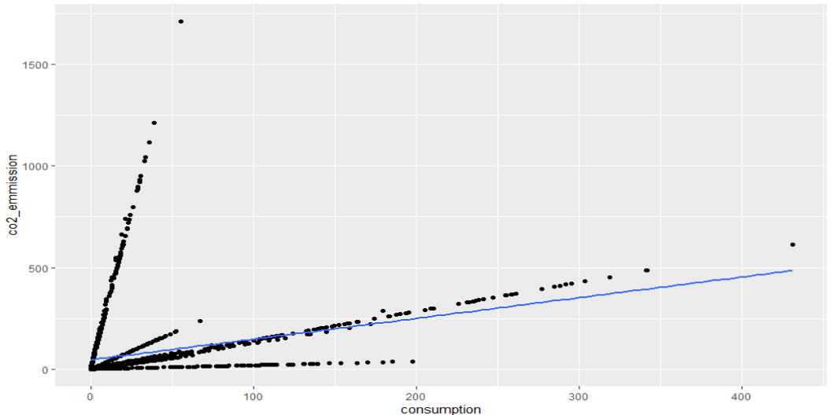
Relation between the consumption and the final co2_emmission

Slide 11

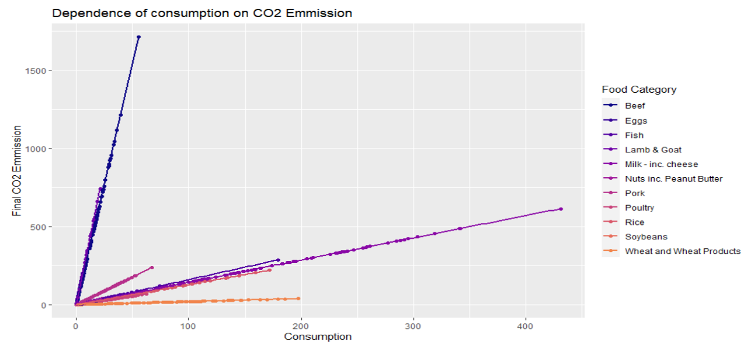
What is the relation between the consumption and the final co2_emmission depending on food_category?

Slide 12

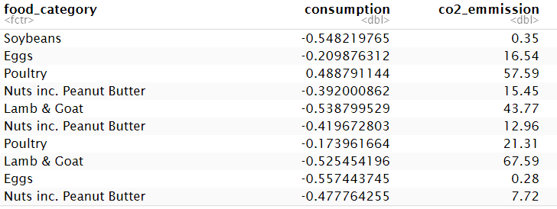
Split the dataset into Training & Testing datasets

Slide 13
Is Emmission Increased when consumption increased?
Yes, Emission is increasing when Consumption is increased

Slide 14

Solution
Try having food types those are less in fat and prefer green foods which is good for health and helps in reducing emissions.

Slide 15


Thank you

